Slide 1

Risk of Alzheimer’s
By: Shrey Patel, Anthony Shajan, Dulce Osorio

Slide 2
Business Problem
Early stages of Alzheimer's have subtle symptoms leading to missed diagnosis
Delayed intervention impacts quality of life and prognosis
Need accurate predictive method to identify high risk individuals

Slide 3
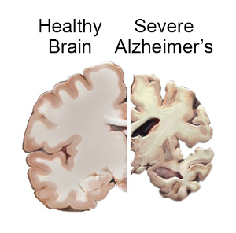
Dataset
This is a longitudinal dataset tracking brain volumes, demographic information, and cognitive assessments for older adults categorized as nondemented, demented, or converted to dementia over multiple visits spanning several years. It enables analysis of how brain volumes and cognition change over time across the different groups.
the OASIS longitudinal dataset enables crucial aging and Alzheimer's disease research by providing rare openly available serial MRI scans with matched clinical data tracked over time for analysis. The sample provided here is drawn from this valuable longitudinal data resource.
This dataset was collected from Kaggle

Slide 4
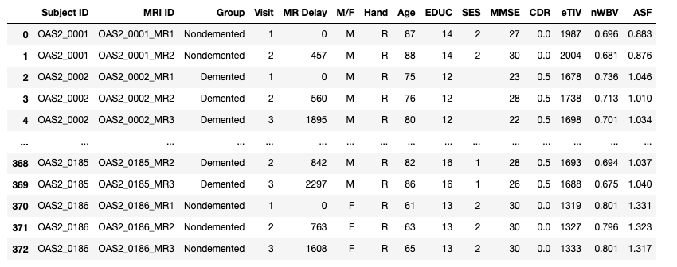
Dataset

Slide 5
The key features of the dataset
Subject ID: Unique identifier for each subject in the study.
MRI ID: Unique identifier for each MRI scan performed on a subject.
Group: Categorization of the subject into a specific group. In this dataset, the groups are "Nondemented" and "Demented," indicating the cognitive status of the individuals.
Visit: Visit number, indicating the order of the MRI scan for a particular subject.
MR Delay: Time delay (in days) between the baseline visit (Visit 1) and the current MRI scan.
M/F: Gender of the subject (M for Male, F for Female).
Hand: Handedness of the subject (e.g., R for Right).
Age: Age of the subject.
EDUC: Years of education completed by the subject.
SES: Socioeconomic status of the subject.
MMSE: Mini-Mental State Examination score, a measure of cognitive function.
CDR: Clinical Dementia Rating, a numeric scale used to assess the severity of dementia.
eTIV: Estimated Total Intracranial Volume, a measure of the brain's total volume.
nWBV: Normalized Whole Brain Volume, a measure of the brain volume normalized by the estimated total intracranial volume.
ASF: Atlas Scaling Factor, a scaling factor applied to transform the spatial information of the brain.

Slide 6

Features impact
Age:
Alzheimer's risk doubles about every 5 years after age 65. In late-onset AD, the strongest risk factor is increasing age.
Autopsy studies show plaques and tangles in the brain increase with older age, even in cognitively normal individuals. Age-related changes may reduce the brain's ability to compensate for developing AD pathology.
Older age of symptom onset is linked to faster progression of cognitive decline in Alzheimer's patients. An older brain may be less resilient to accumlating damage.
Education:
More education contributes to greater cognitive reserve -i.e having a buffer to endure age-related and AD-related changes before clinical symptoms emerge.
Higher education is associated with reduced rate of hippocampal atrophy and memory decline in AD. It enables better neural efficiency and compensation to delay onset of impairment.
Education may also protect through mentally stimulating activities that activate compensatory processes and increase synaptic density. Enriched environments can reduce amyloid load in animal models.

Slide 7

Features Impact
CDR Score:
The clinical dementia rating scale quantifies cognitive and functional impairment in six areas - memory, orientation, judgement, community affairs, home activities, and personal care.
CDR staging matches progression of pathological brain changes in AD - early amyloid pathology prior to symptoms, mild cognitive impairment, then neocortical damage and impaired daily functioning indicating dementia.
A higher CDR score denotes greater severity of clinical dementia on a scale of 0 to 3. A score of 0.5 progressing to 3 shows advancing disease.
MMSE Score:
The mini-mental state exam tests various cognitive domains including memory, attention, language, praxis and visuospatial abilities.
Declining MMSE scores indicate worsening cognition over time in AD patients, correlating with advancing neurodegeneration on brain imaging.
A MMSE below 24 suggests pathology beyond normal aging. Scores below 10 imply very severe, late-stage AD with global cognitive deficits.

Slide 8
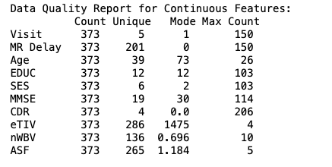

Continuous & Categorical Features

Slide 9
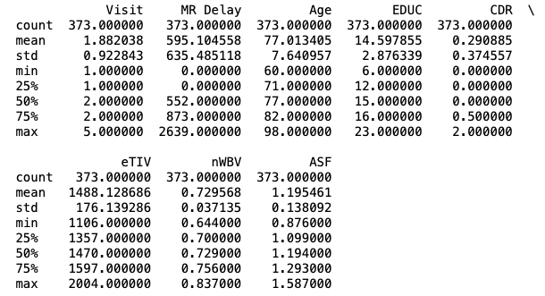
Statistical summary of dataset

Slide 10
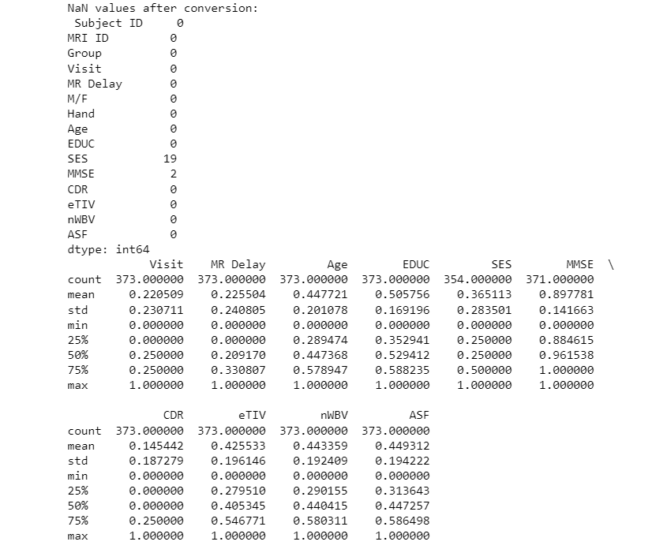
Data Normalization

Slide 11
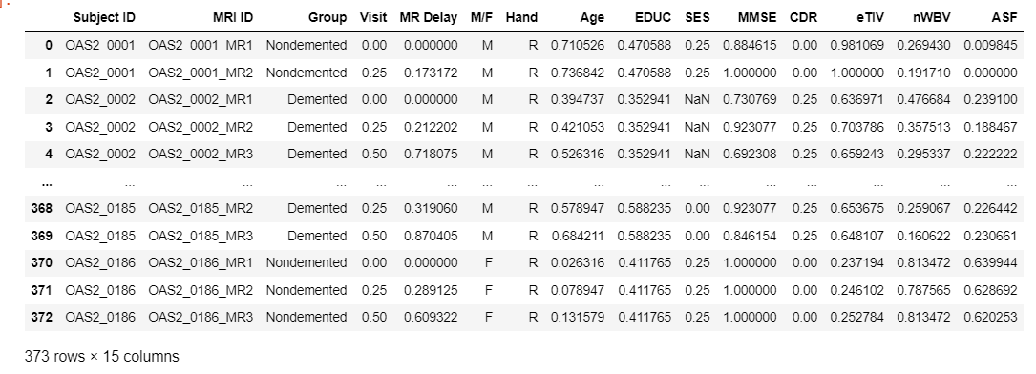
Normalization

Slide 12
Data Exploration
Handled missing values with median imputation
Identified and removed outliers based on z-scores
Assessed distributions and patterns in features
Normalized continuous features for consistency

Slide 13
Imputation and Outliers
Due to some rows having missing values, our random forest classifier couldn’t handle predicting as we kept encountering value errors.
Thus, we used median for imputation and Z-score for outliers. It first handles missing values by converting non-numeric values in continuous features to numeric and imputing missing values with the median.
Then, it removes outliers from the continuous features using a Z-score threshold of 3. The preprocessing steps include using scikit-learn's Simple Imputer for imputation and determining outliers based on the Z-score. After removing outliers, DF now has 358 rows instead of 373. In addition, we made a separate DF just for outliers.

Slide 14
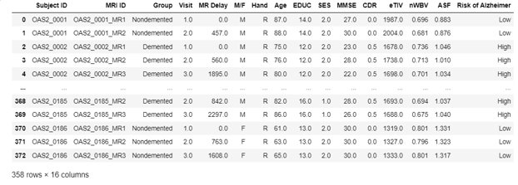
DataFrame without Outliers

Slide 15
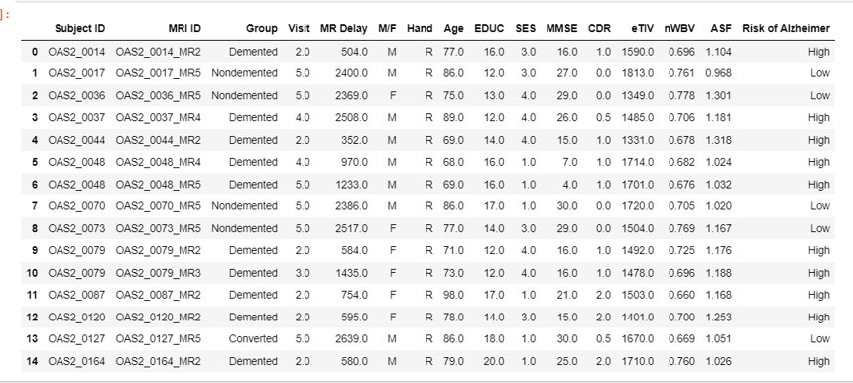
DataFrame of Outliers

Slide 16
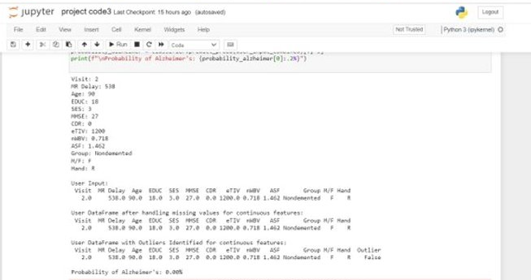
Classifier

Slide 17
Classifier
The code first collects user input for both continuous and categorical features, converts it into a DataFrame.
It then identifies outliers in the continuous features, one-hot encodes categorical features, and combines all features into a format suitable for the pre-trained random forest classifier.
The classifier predicts the probability of Alzheimer's disease for the user input, utilizing the model previously trained on a dataset, and the result is printed for user interpretation.
Now that we have a classifier, we used this to add a column to the data frames that calculates the risk of Alzheimer's, then returning a high or low value.

Slide 18
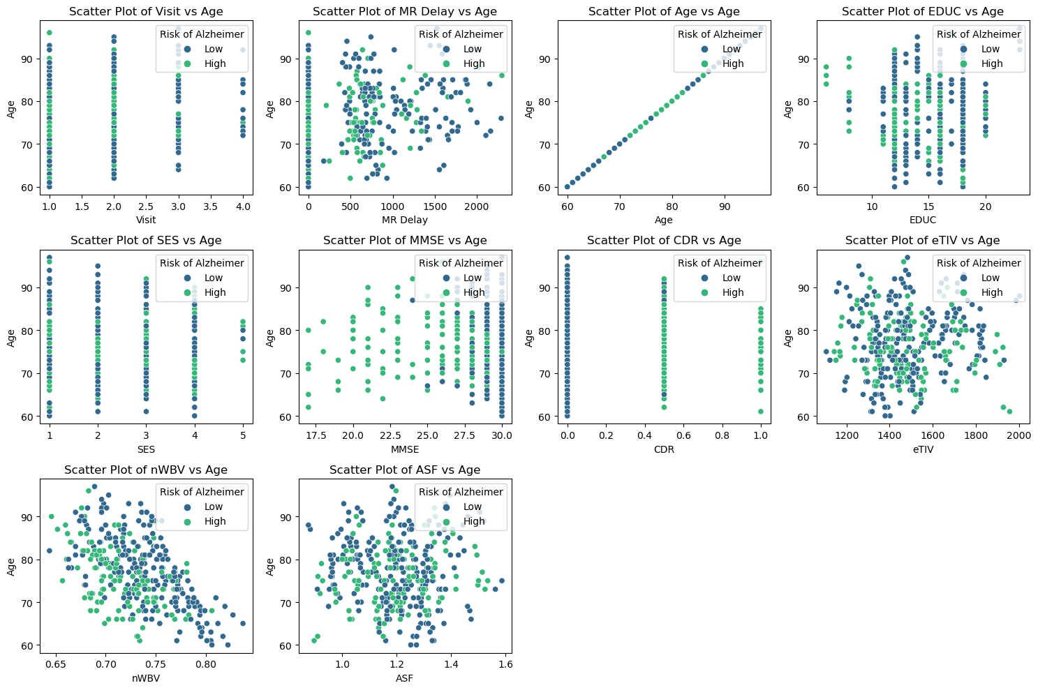
Scatterplots
Older individuals had more of a risk based off the scatter plots
Lower MMSE had higher risks
Higher CDR had higher risks
Lower eTIV and nWBV resulted in higher risks

Slide 19
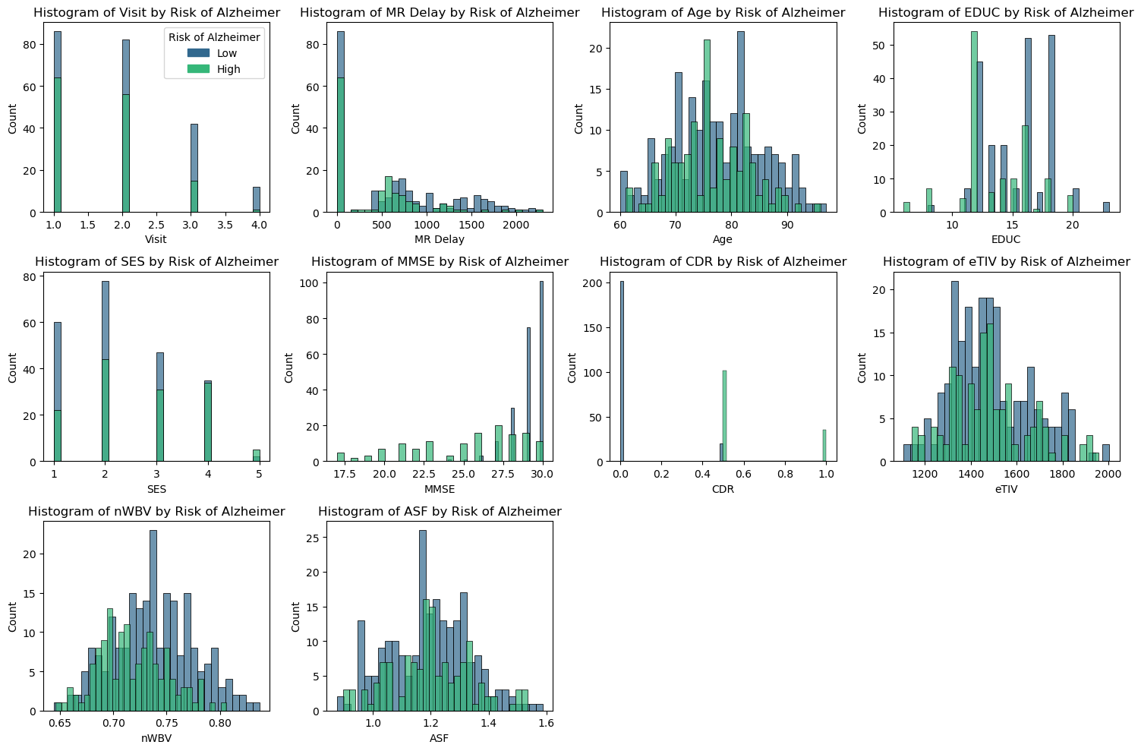
Alzheimer's Risk with Age
Once again, we can see here that lower eTIV and nWBV resulted in higher risks. Lower levels of education showed more risk.

Slide 20
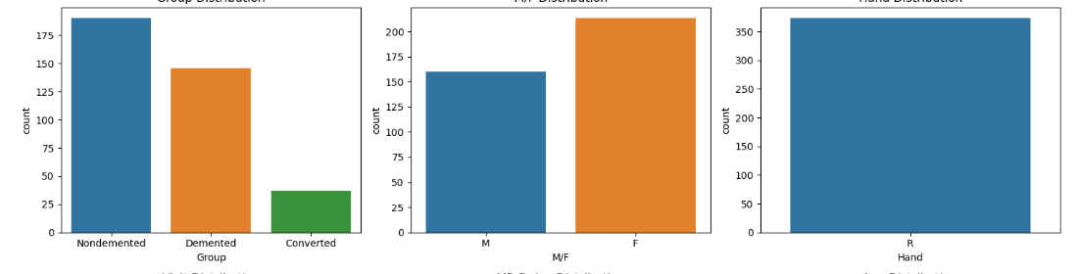
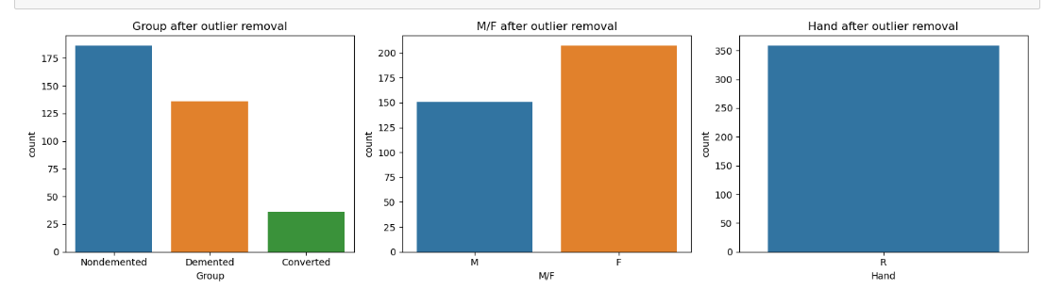
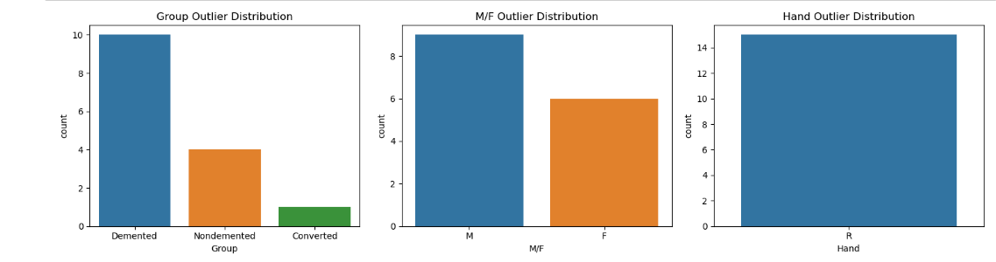
Comparison of Histograms of Categorical Features

Slide 21
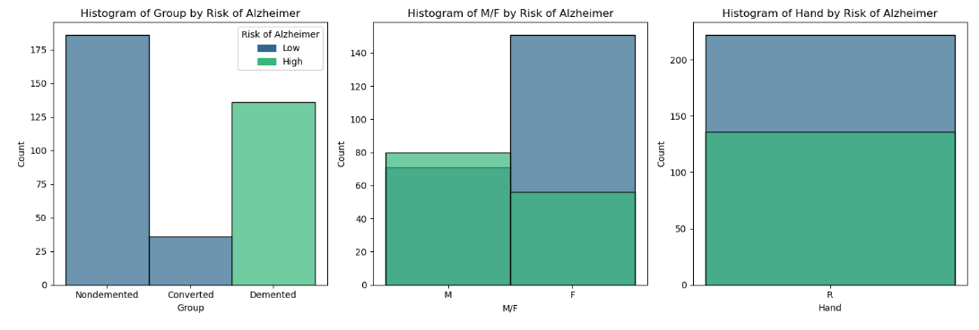
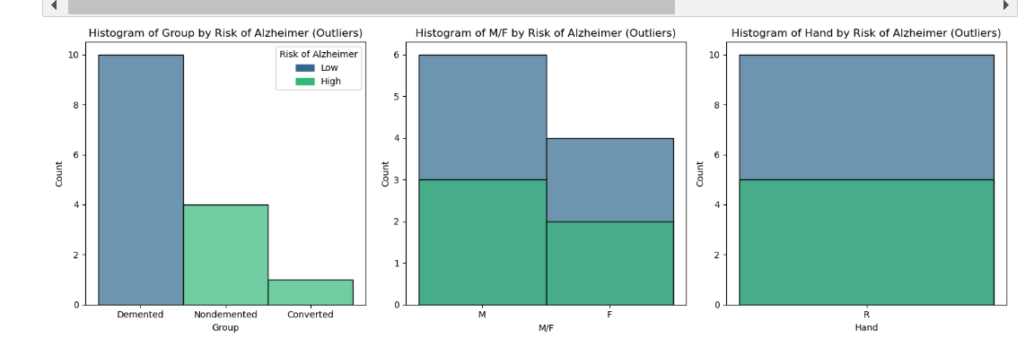

Slide 22
Confusion Matrix Results
87% accuracy on held-out test set
High precision - 95% of positive predictions correct
Confusion matrix shows strong true positive rate
Few false negatives missed relative to size
(Age, Gender, & Education were the top 3 main factors)

Slide 23
Steps for Prevention
There are steps we can take early on to prevent all of us from potentially obtaining this disease.
Move Your Body:
Regular exercise significantly lowers the chances of Alzheimer's. Stay active, and studies show you'll be less likely to get the disease.
Eat Well:
A healthy diet is crucial. Focus on fruits, veggies, whole grains, and omega-3 fatty acids to cut your risk of Alzheimer's.
Keep Your Mind Busy:
Do mental exercises and keep learning. This helps build a strong brain and might delay Alzheimer's symptoms.
Stay Social:
Being socially active lowers the risk of cognitive decline and Alzheimer's. Keep up with friends and stay engaged.
Manage Health Issues:
Take care of conditions like diabetes and high blood pressure. Regular check-ups and a healthy lifestyle help protect your brain from Alzheimer's risk.

Slide 24
Conclusion
Demonstrated feasibility of ML for early detection
Provides interpretable risk assessment tool
Enables timely interventions to slow progression
Future work to expand features and data samples

